Slide 1
Architectural Frameworks
Parameswari Ettiappan

Slide 2
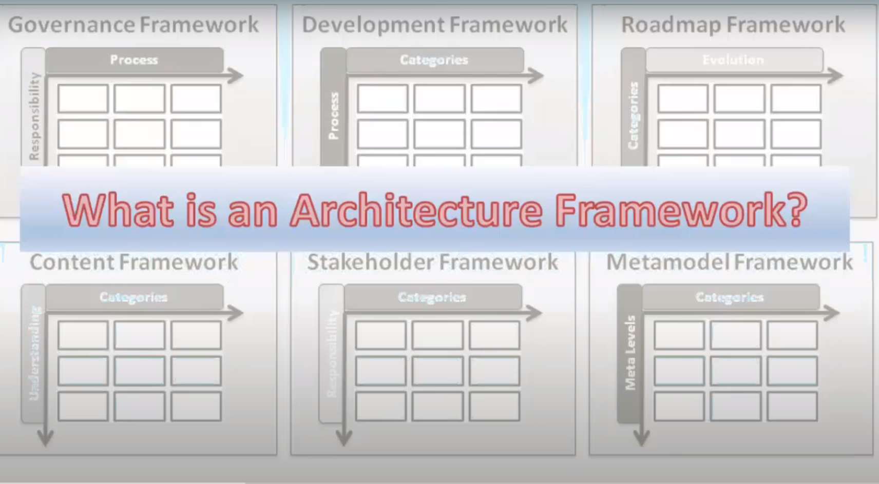

Slide 3
Governance Framework
COBIT: the acronym refers Control Objectives for Information and Related Technology.
ITIL: it is most widely adopted IT service management framework in the world.
COSO: it is framework for corporate governance.
CMMI: this acronym stands for Capability Maturity Model integration.
FAIR: it refers Factor analysis of Information Risk. It is risk management frameworks help organizations analyze, understand, and measure information risk.

Slide 4
RoadMap Framework
Agile
Scrum
Kanban
Scaled Agile Framework® (SAFe) roadmap

Slide 5
Content Marketing Framework
Simple warm acquisition(InVision)
B2B sales and lead generation(Auto Pilot)
Ecommerce (Simplified) (BeardBrand)
Evergreen forest(WebMD)
Competitive SEO (SlideBean)
“Trifecta” strategy (Nerd Wallet)

Slide 6
Stakeholder Framework
Praxis Framework (CMM Framework)
Scaled Agile

Slide 7
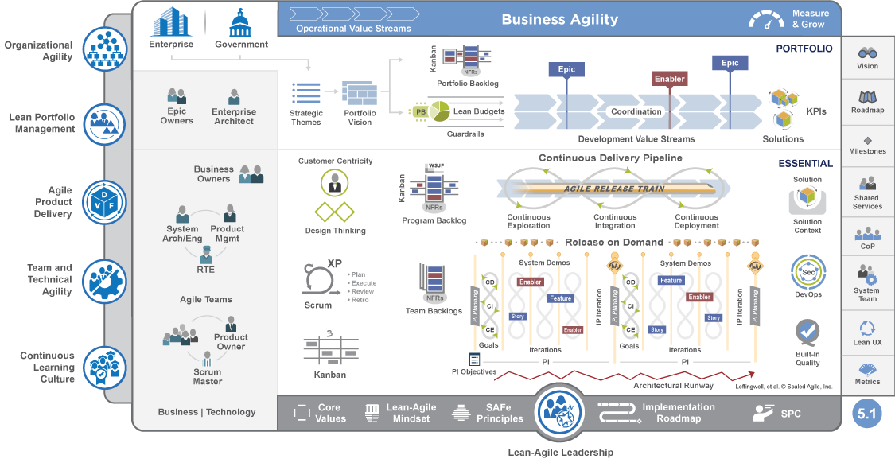

Slide 8
Metamodel Framework
UML,SysML
Apache MetaModel

Slide 9
Enterprise Architecture – Definition & Drivers
Enterprise architecture is defined as “the set of architectural concepts, principles, guidelines, blueprints, standards, and other enterprise-wide deliverables that guide an enterprise through acquiring, outsourcing,integrating, connecting, developing, modifying, operating, and retiring the elements (internal and external to the enterprise) of an IT portfolio.
- Cutter Consortium

Slide 10
Why Enterprise Architecture?
Need for an efficient, faster, consistent, flexible and predictable technology support to the businesses
Need for faster time to market
Complex integration issues due to inconsistent and unsound technology
Chaotic technology landscape due to mergers and acquisitions
Lack of processes (architecture definition, technology selection, EA team funding, IT procurement etc.)
Lack of proper technology strategy planning in line with business planning

Slide 11
Architecture in an Enterprise can be viewed in 3 Layers
Acronyms used in this document
• AD / M – Application Development / Maintenance
• BU – Business Units
• EA – Enterprise Architecture
• LOB – Line of Business

Slide 12
Degrees of freedom Vs Standardization

Slide 13
Our Proposition on Enterprise Architecture

Slide 14
Total Cost of Ownership (TCO)
Gartner defines total cost of ownership (TCO) a comprehensive assessment of information technology (IT) or other costs across enterprise boundaries over time.
For IT, TCO includes hardware and software acquisition, management and support, communications, end-user expenses and the opportunity cost of downtime, training and other productivity losses.

Slide 15
Benefits

Slide 16
Architecture Description Framework (ADF) for
Enterprise Applications

Slide 17
ADF
Among the various steps in EA definition, the focus is to prescribe the right description framework for project architecture and LOB architecture

Slide 18
Need for the “right” description of architecture of enterprise applications
The architecture should describe the whole system at different levels of granularity depending on the hierarchy level of stakeholder.
The architecture should describe different architectural aspects of the system focusing one at a time so as to help separate concerns of the stakeholders
The software architecture of the system should take into account the enterprise and LOB level standards as well as architectural principles.
To achieve the above, the Architecture Description Framework (ADF) should
Provide guidelines and best practices for easy adoption
Provide tight coupling between the LOB target architecture and project architectures

Slide 20
LOB Architecture Models

Slide 21
Definitions

Slide 22
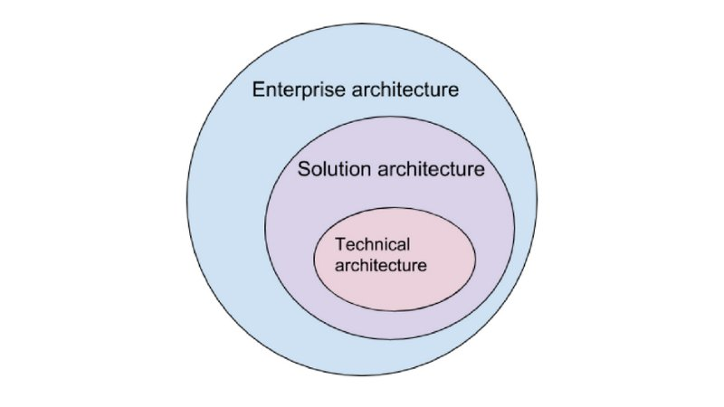
Solution architecture in the context of the enterprise and technical architecture

Slide 24
Building Blocks

Slide 25
Building Blocks

Slide 26
Building Blocks

Slide 27
Building Blocks

Slide 28
Building Blocks

Slide 29
Building Blocks

Slide 30
Building Blocks

Slide 31
Enterprise Understanding

Slide 32
Architecture Planning

Slide 33
Business Architecting

Slide 34
Technical Architecting

Slide 35
Architecture Validation

Slide 36
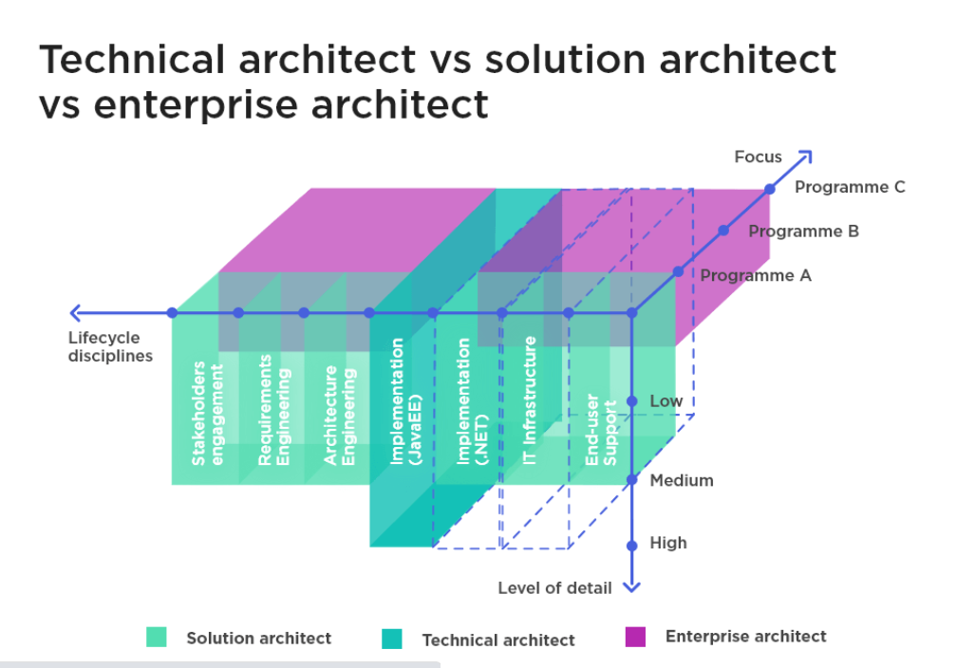
Solution architecture in the context of the enterprise and technical architecture

Slide 37
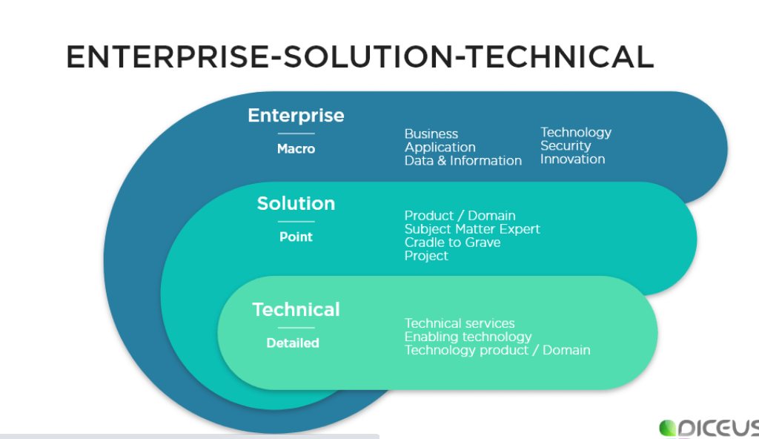
Solution architecture in the context of the enterprise and technical architecture

Slide 38
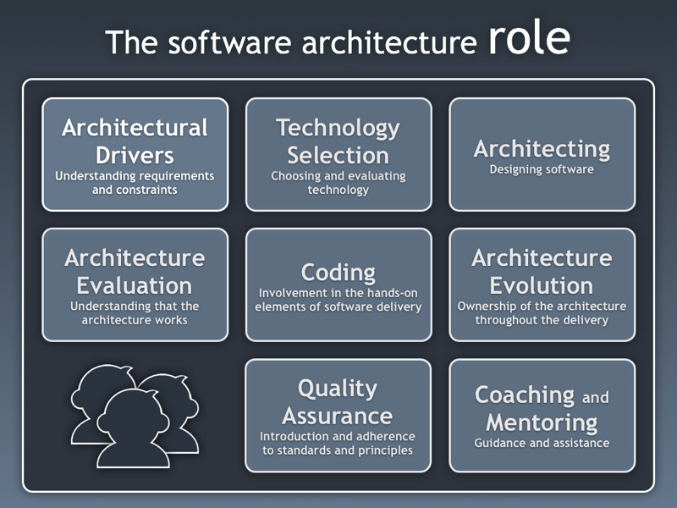

Slide 39
Types of software architects
Architect type | Strategic thinking | System interactions | Communication | Design
enterprise architect | across projects | highly abstracted | across organization | minimal, high level
solutions architect | focused on solution | very detailed | multiple teams | detailed
application architect | component re-use, maintainability | centered on single application | single project | very detail

Slide 40
Architecture Framework
An architecture framework is an encapsulation of a minimum set of practices and requirements for artifacts that describe a system's architecture.

Slide 41
Architecture Framework
An architecture Framework contains both the tools and the methods for creating and managing enterprise architectures.
This includes
the processes and tools that are used to create the architectures.
the repository that stores the architecture content.
the organization of the team, including guidance on how to create the architectures and the governance of the teams that implement the architectures.

Slide 42
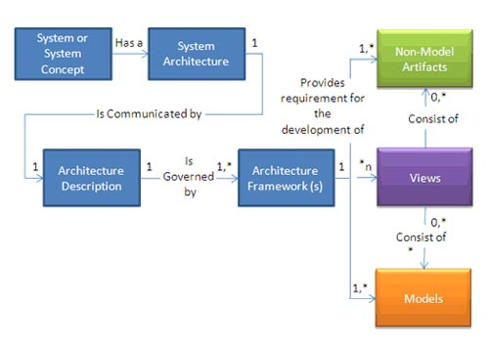

Architecture Framework

Slide 43
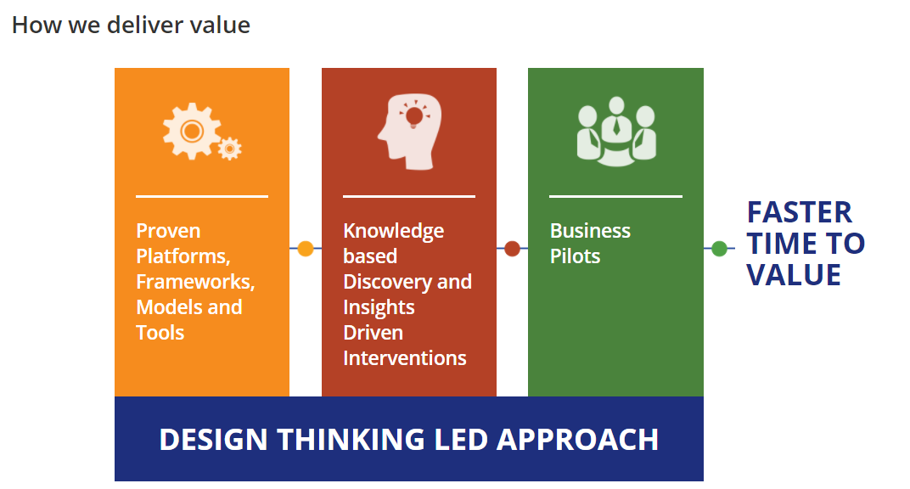
Architecture Framework

Slide 44
Getting Started
Systems are multidimensional in nature and have ‘n’ stakeholders with different concerns.
Architecture frameworks enable the creation of system views that are directly relevant to stakeholders' concerns.
Often, multiple models and non-model artifacts are generated to capture and track the concerns of all stakeholders.

Slide 45
Getting Started
By interacting with intra- and extra-program stakeholders, including users, experimenters, acquirers, developers, integrators, and testers, key architectural aspects that need to be captured and communicated in a program are determined.
These architecture needs then should be consolidated.
It is then taken as recommendation to develop and use specific models and views that directly support the program's key decisions and activities.

Slide 46
Getting Started
Concurrently, an architecture content and development governance structure should be developed to manage and satisfy the collective needs.

Slide 47
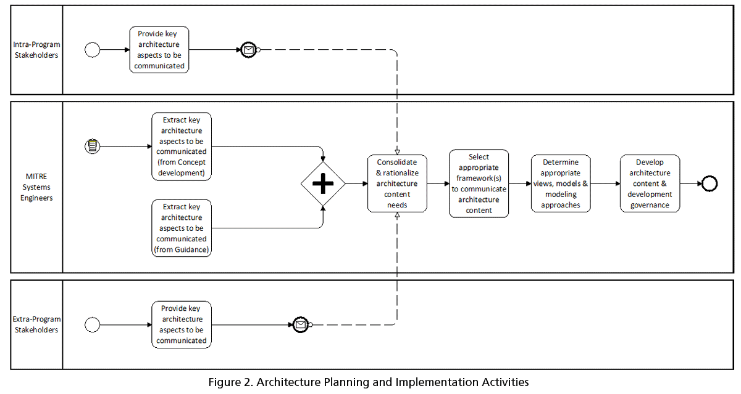
Architecture planning and implementation activities

Slide 48
APPROACHES TO ARCHITECTURE DEVELOPMENT
Architecture development can be thought of as both a process and a discipline that aids the development of mission-effective systems.
Multiple complementary approaches and methodologies are used to develop enterprise and system architectures.

Slide 49
APPROACHES TO ARCHITECTURE DEVELOPMENT
Some of the most popular approaches used in government departments and agencies are:
U.S. Department of Defense Architecture Framework (DoDAF)
The Open Group Architecture Framework (TOGAF)
Object-oriented with Unified Modeling Language
Spewak architecture process and Zachman Framework

Slide 50
Key Steps
Define the architecture purpose, value, and decisions it will support.
Get information needed to define the architecture from stakeholders as early as possible.
Create, refine, and update the architecture in an iterative way throughout the acquisition life cycle.
Validate the architecture will meet expectations when implemented.
Define roles for team members to guide and coordinate their efforts.

Slide 51
Key Steps
Create estimates and schedules based on the architectural blueprint.
Use the architecture to gain insight into project performance.
Establish a lightweight, scalable, tailorable, repeatable process framework.

Slide 52
Determining the Right Process/Method
Many systems engineers believe there is an "either-or" decision to be made regarding different architectural frameworks (e.g., DoDAF or TOGAF).
But this is not necessarily the case.
Some architectural standards address completely different elements of the architecting process.
For example, TOGAF has a primary focus on architecture methodology—the "how to" aspect of architecting, without prescribing architecture description constructs.
DoDAF has a primary focus on architecture description via a set of viewpoints, without a detailed specification of methodology [

Slide 53
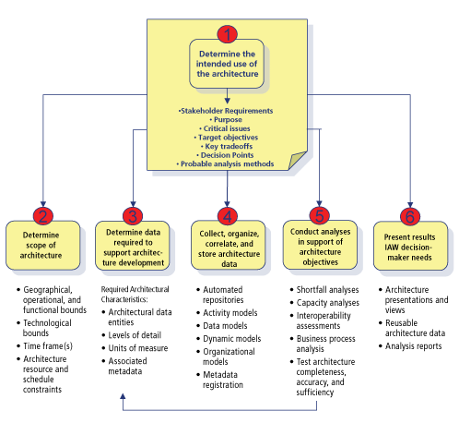
DoDAF 6-Step Architecture Process

Slide 54
TOGAF Architecture Development Method (ADM)
The TOGAF Architecture Development Method (ADM) provides a tested and repeatable process for developing architectures.
It is a generic method for architecture development that is designed to deal with most systems.
However, it will often be necessary to modify or extend the ADM to suit specific needs.
One of the tasks before applying the ADM is to review its components for applicability, and then tailor them as appropriate.

Slide 55
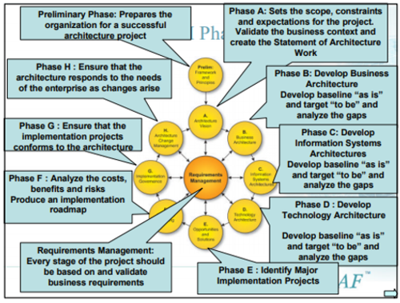
TOGAF Architecture Development Method (ADM)

Slide 56
TOGAF Architecture Development Method (ADM)
The Preliminary Phase describes the preparation and initiation activities required to prepare to meet the operational directive for a new architecture, including the definition of an organization-specific architecture framework and the definition of principles.
Phase A: Architecture Vision describes the initial phase of an architecture development cycle.
It includes information about defining the scope, identifying the stakeholders, creating the architecture vision, and obtaining approvals.

Slide 57
TOGAF Architecture Development Method (ADM)
Phase B: Business Architecture describes the development of a business architecture to support an agreed architecture vision.
Phase C: Information Systems Architectures describes the development of information systems architectures for an architecture project, including the development of data and application architectures.

Slide 58
TOGAF Architecture Development Method (ADM)
Phase D: Technology Architecture describes the development of the technology architecture for an architecture project.
Phase E: Opportunities and Solutions conducts initial implementation planning and identifies delivery vehicles for the architecture defined in the previous phases.
Phase F: Migration Planning addresses the formulation of a set of detailed sequences of transition architectures with a supporting implementation and migration plan.

Slide 59
TOGAF Architecture Development Method (ADM)
Phase G: Implementation Governance provides an architectural oversight of the implementation.
Phase H: Architecture Change Management establishes procedures for managing change to the new architecture.
Requirements Management examines the process of managing architecture requirements throughout the ADM

Slide 60
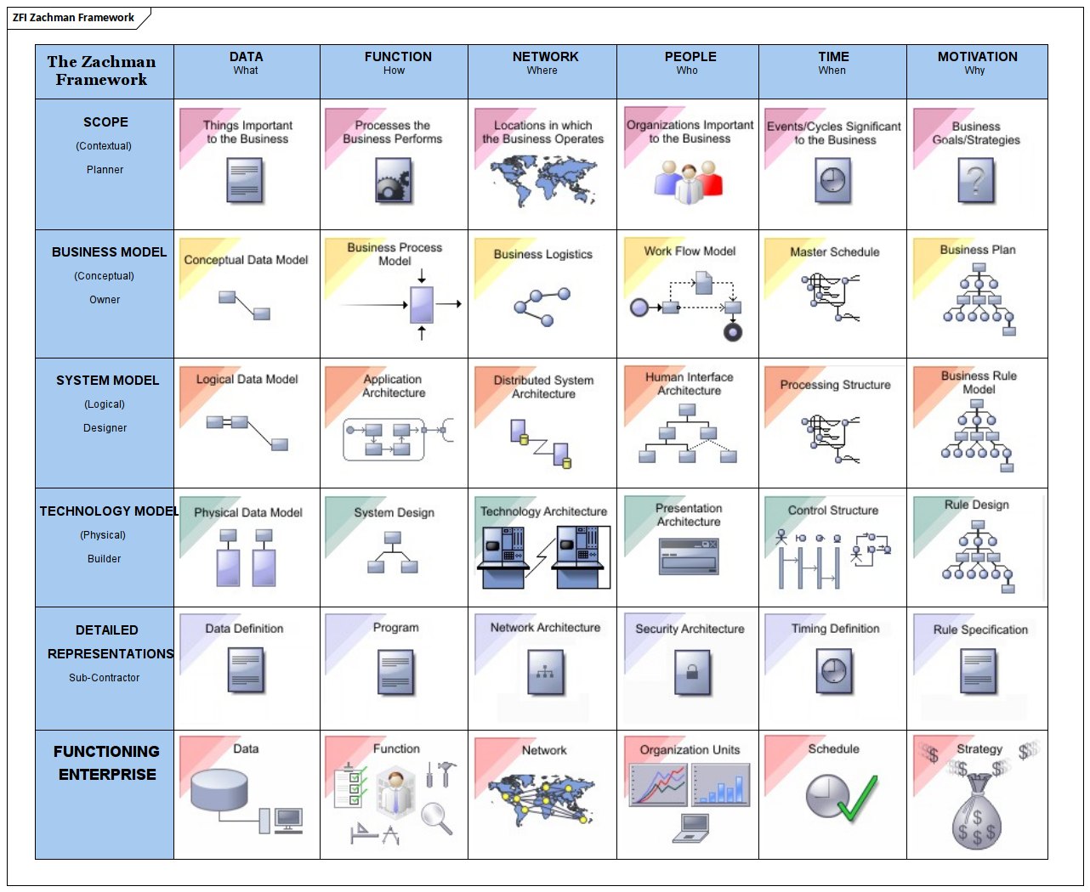
Zachmen Framework

Slide 61
Best Practices and Lessons Learned
Purpose is paramount
A plan is a point of departure
Know the relationships
Be the early bird
No one trusts a skinny cook
Which way is right and how do I get there from here?
Try before you buy.
Taming the complexity beast

Slide 62
Best Practices and Lessons Learned
Keep it simple
Determining the right models and views
But it looked so pretty in the window
How do I create the right views?
Bringing dolls to life
How much architecture is enough?

Slide 63
Questions

Slide 64
Module Summary
Determining the Right Framework
Best Practices and Lessons Learned

